Slide 1
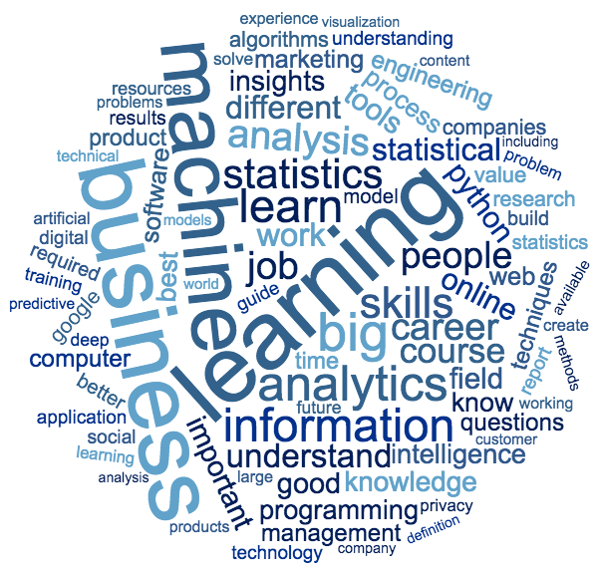
What is Data Science?
(how would you define it?)
Mark A. Jensen, PhD
FNLCR/LBR

Slide 2
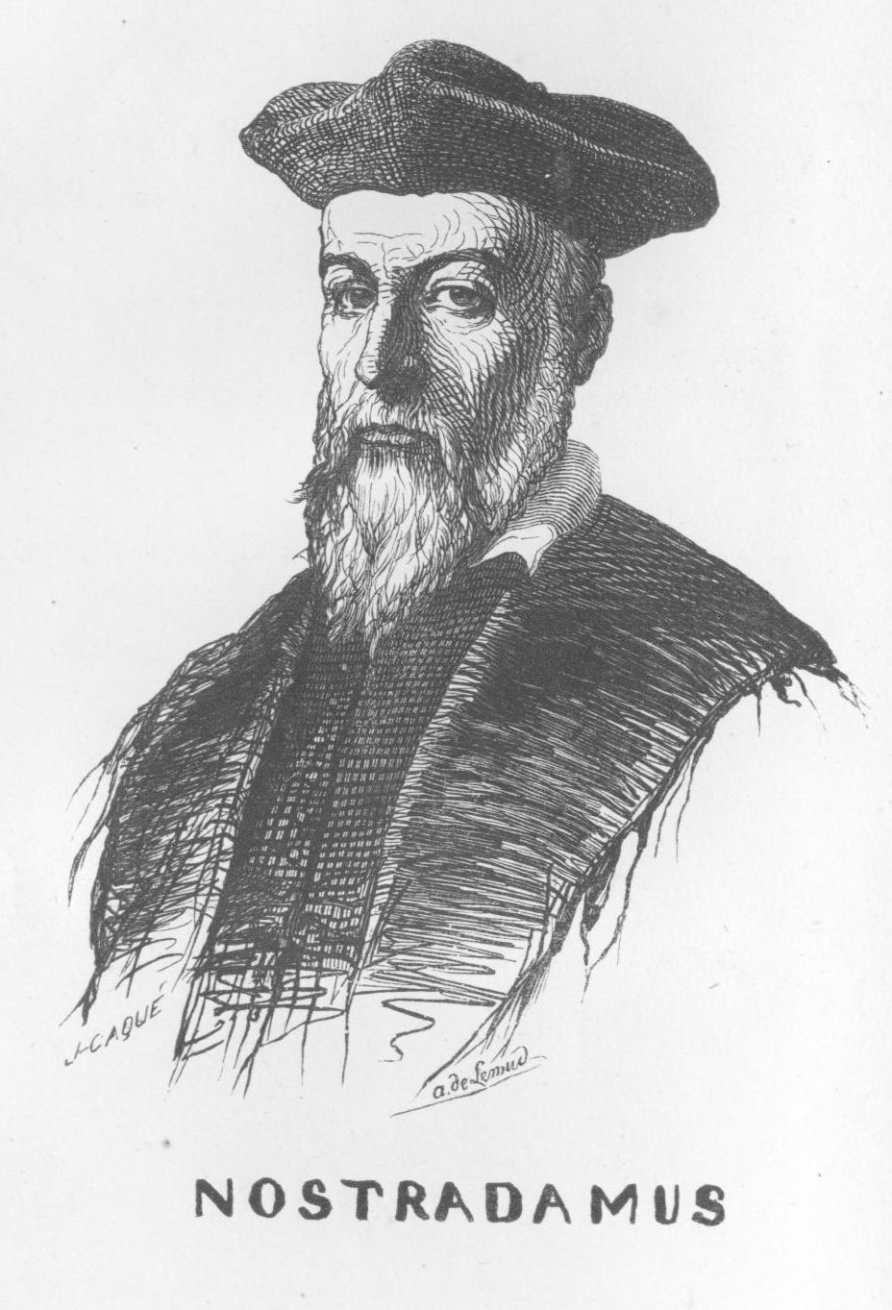
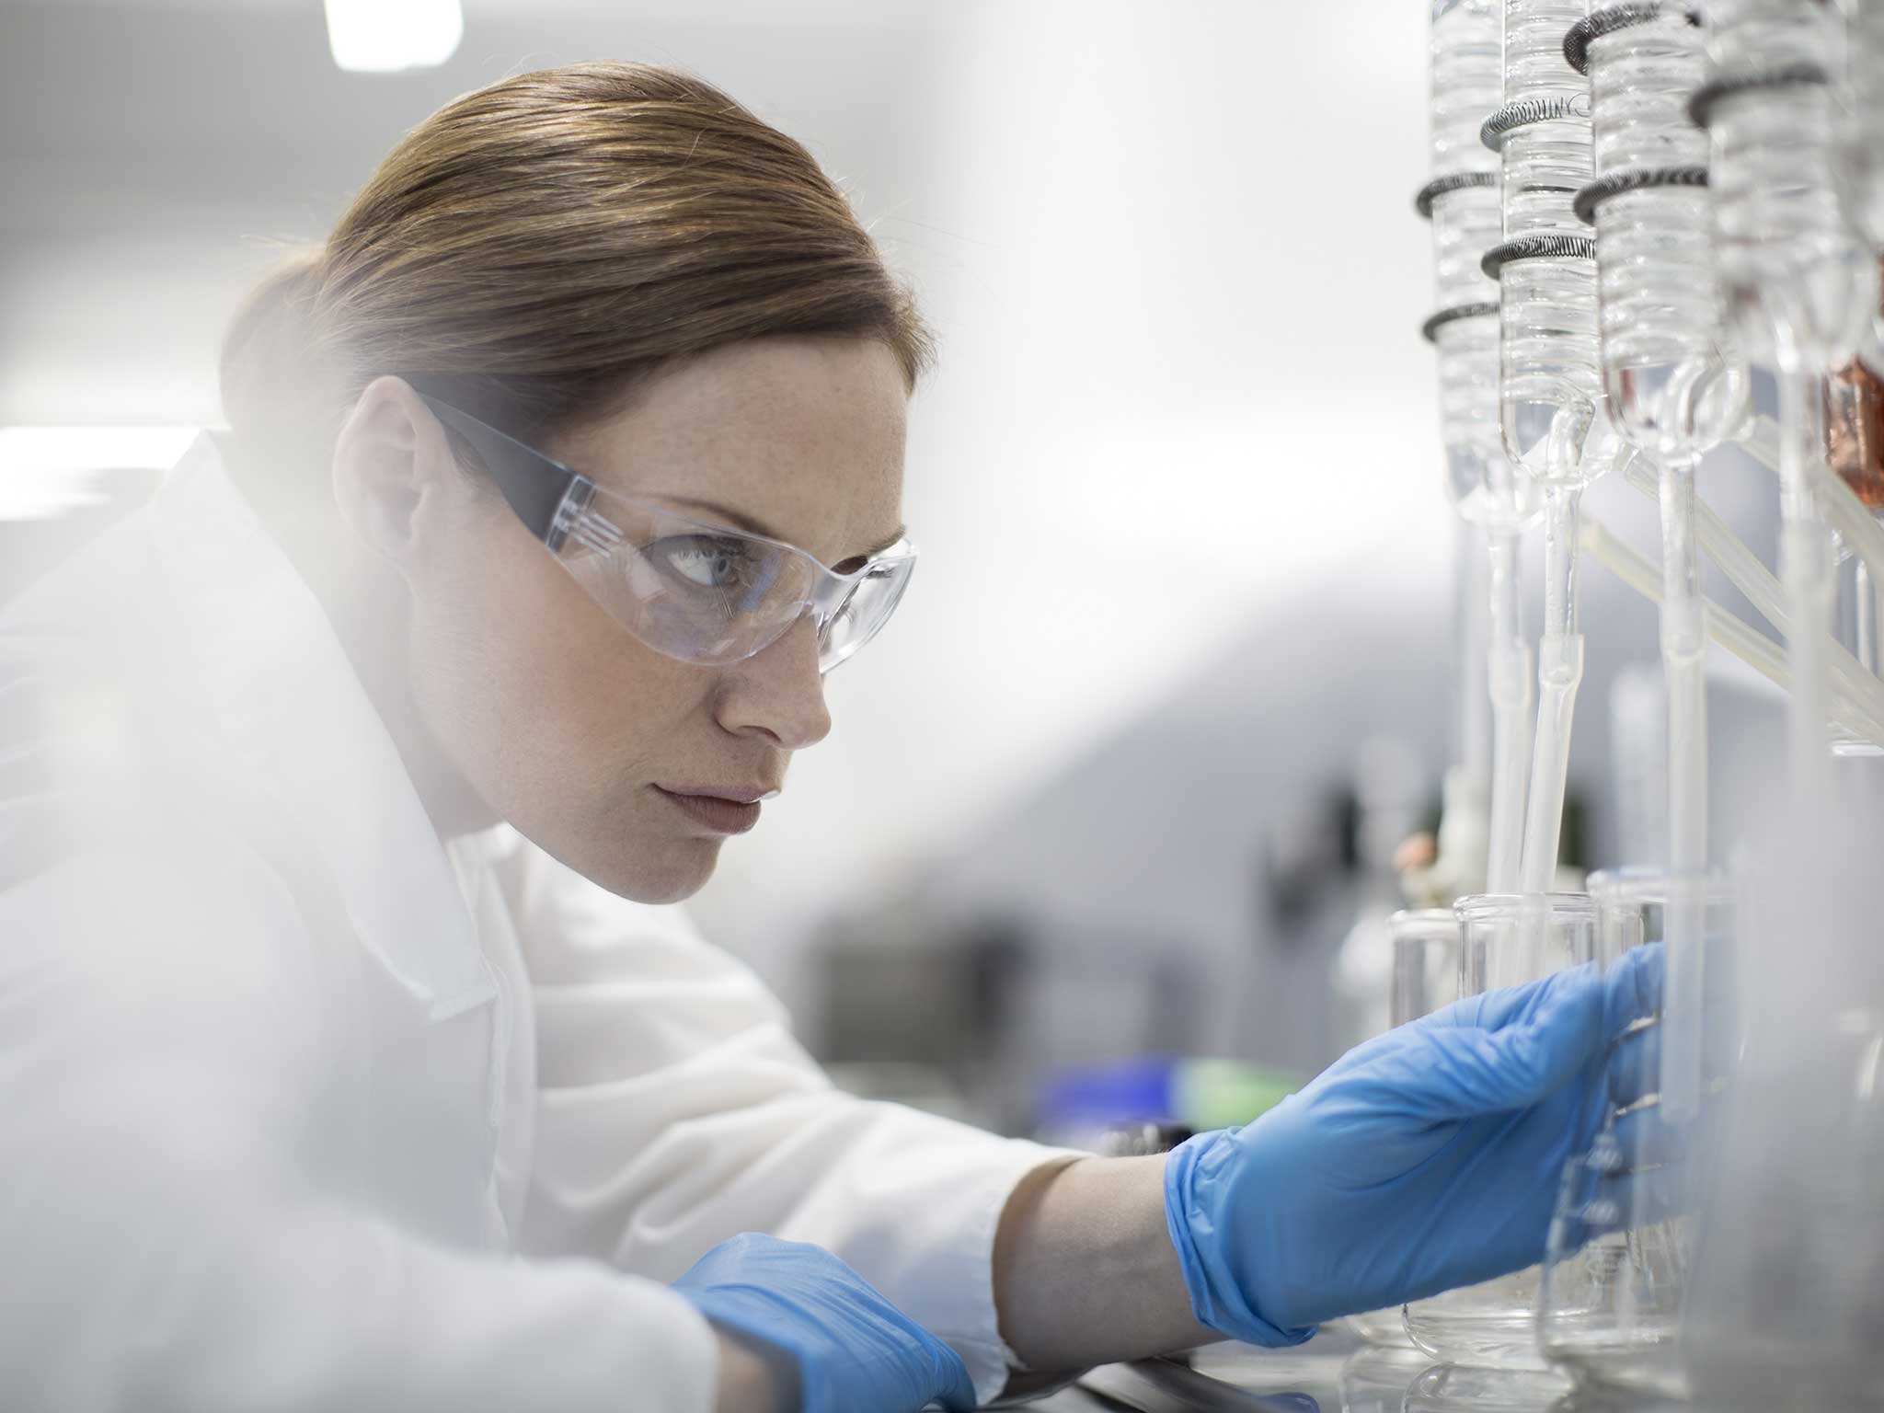

Definitions reveal points of view
“Data science is a multi-disciplinary field that uses scientific methods, processes, algorithms and systems to extract knowledge and insights from structured and unstructured data.”
“Data Science is a combination of scientific disciplines to build predictive models that explore data content patterns,”
“Data science, or data-driven science, combines different fields of work in statistics and computation in order to interpret data for the purpose of decision making.”

Slide 3
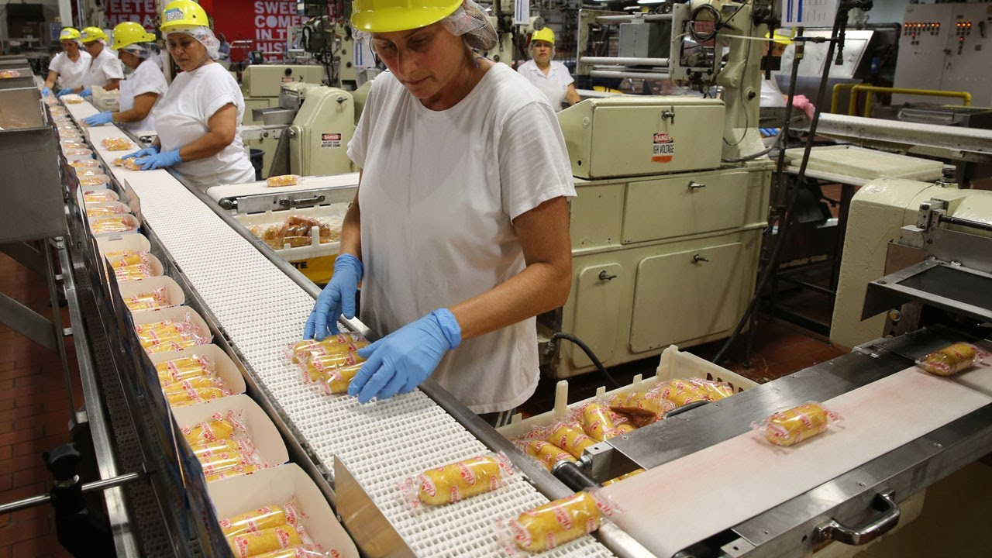


Definitions reveal points of view
“Data science enables the creation of data products.”
“Data science, as it’s practiced, is a blend of Red-Bull-fueled hacking and espresso-inspired statistics.”
“It’s a misconception that data science is an IT function. Data science is a business function.”

Slide 4
Can Data Science help us understand “Data Science”?
Collection
Reduction
Interpretation
Let’s do a data science experiment:

Slide 5
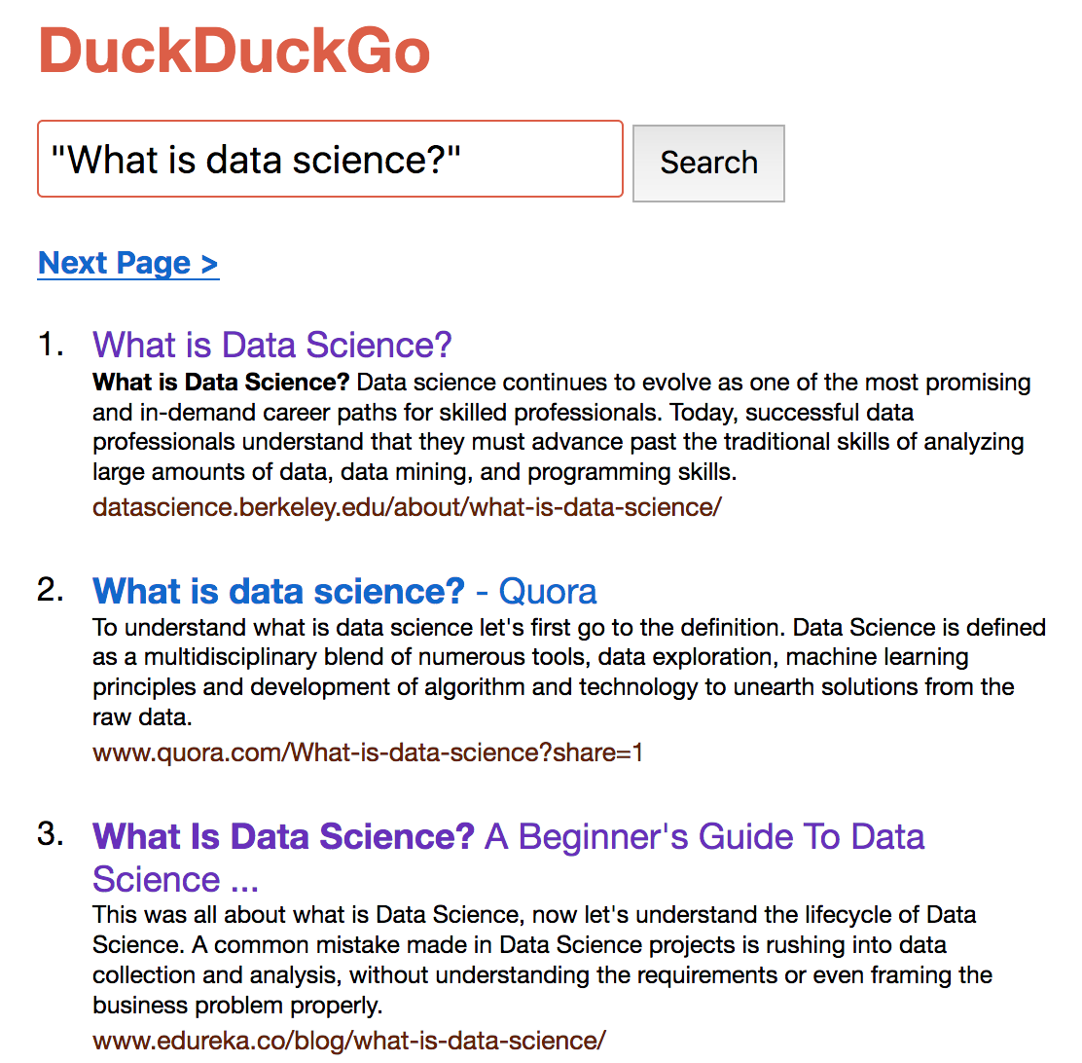
Get Data
Get the text from ~100 pages with the title What is Data Science
Prepare the data

Slide 6
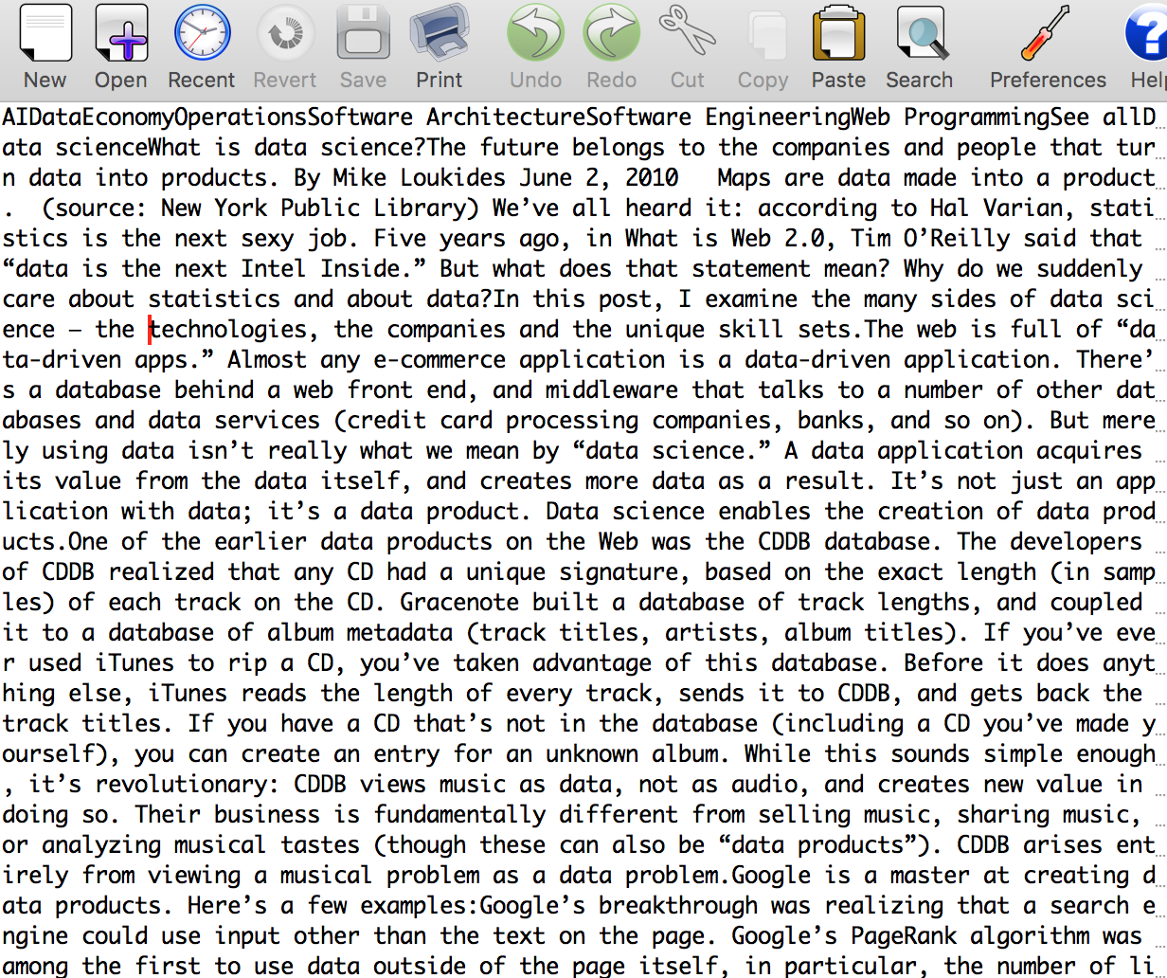
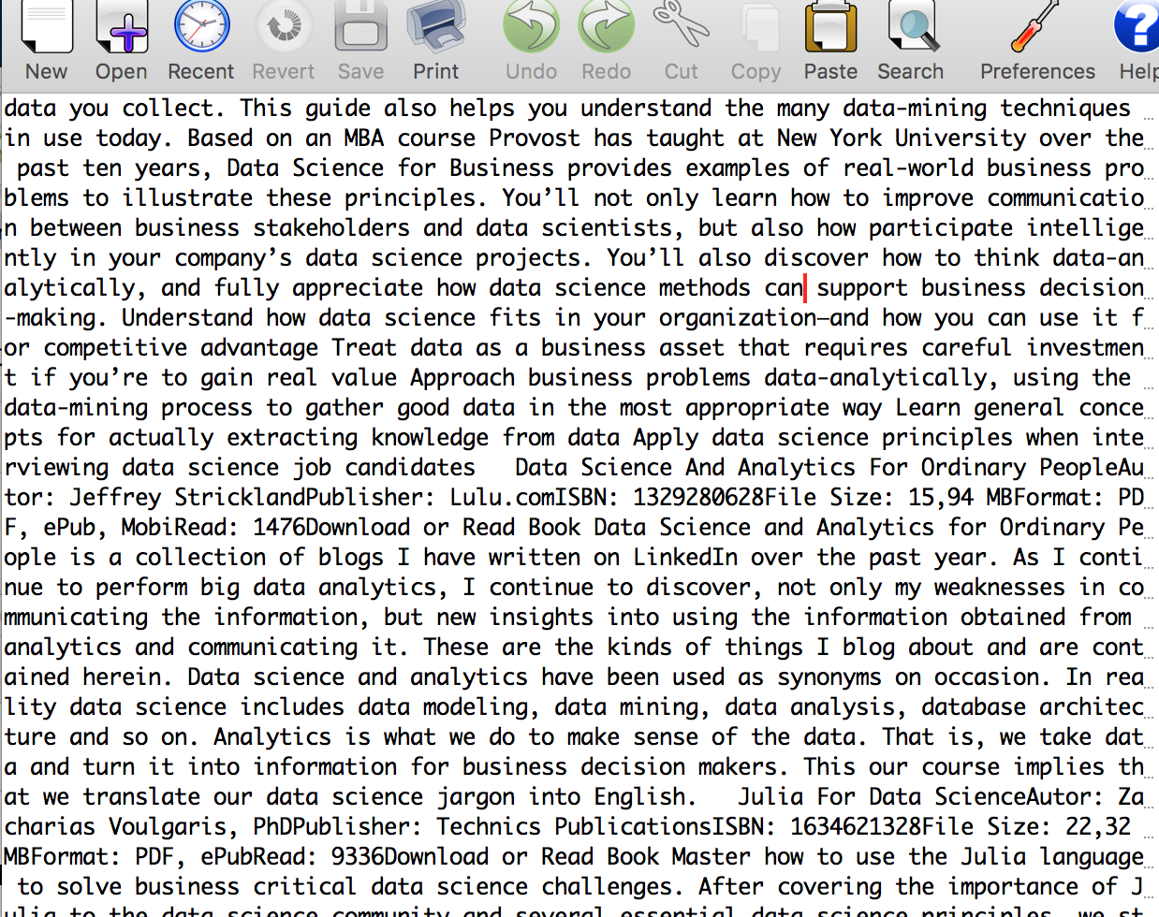
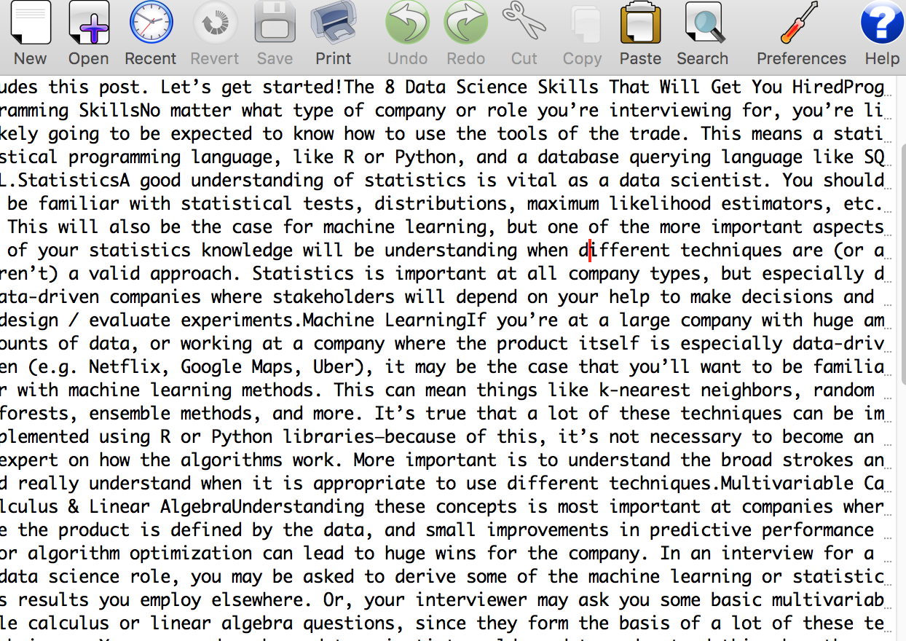
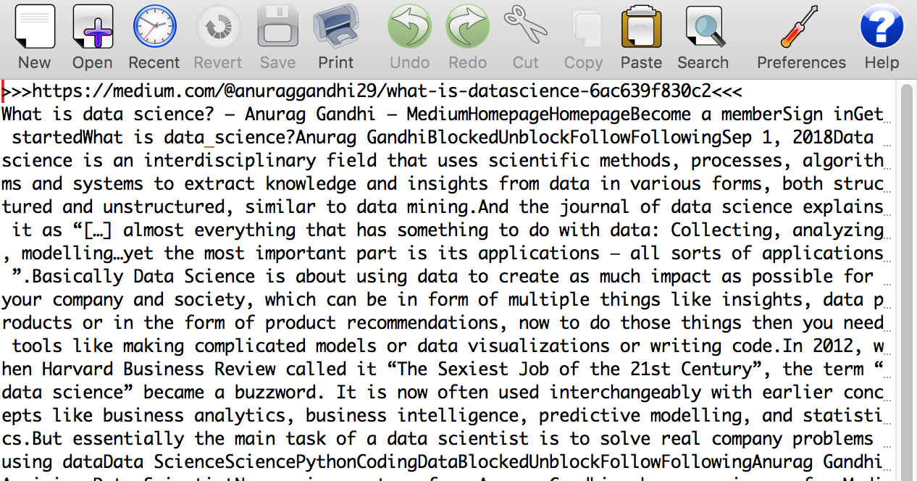
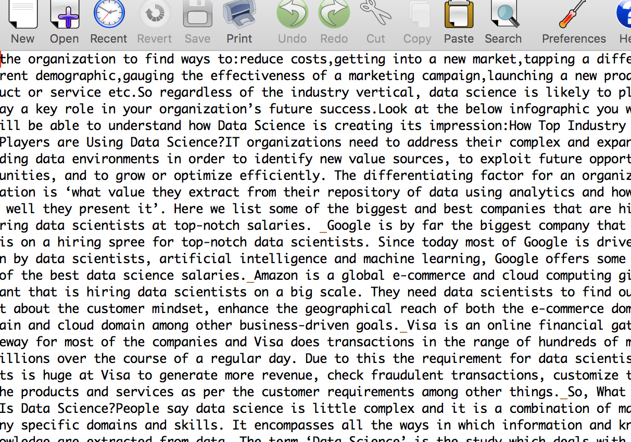
Raw Data:

Slide 7
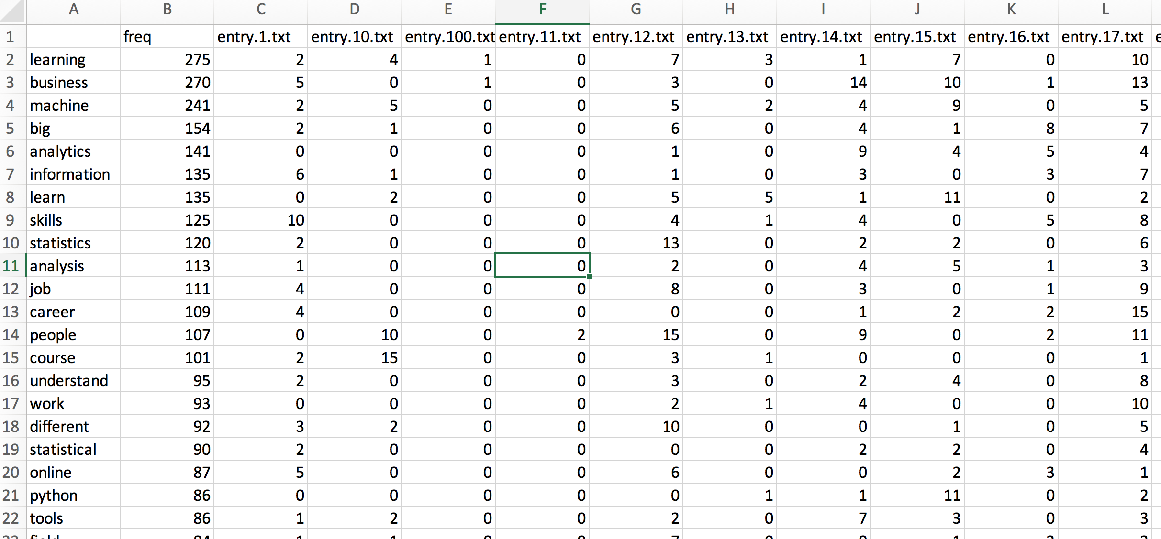
Reduce data
Create a “term-document matrix”

Slide 8
Interpret Data (Find Patterns) : Simple
Frequency of words in sample
(What words are missing?)

Slide 9
Interpret Data (Find Patterns) : Simple
Word Cloud
https://www.wordclouds.com/

Slide 10
Interpret (Find Patterns) : More Complex
Principal components analysis
Biplot
marketing
career
business
big
analytics
skills
analysis
understand
machine
learning

Slide 11
Conclusions?
The Internet is fairly consistent about what it thinks data science is.
There is evidence of at least two strands of thought
Something called “Machine learning” is important to data science
Data science is highly relevant to economic concepts like business, employment, and marketing

Slide 12
Does doing Data Science help us define “Data Science”?
Some terms to add to our matrix
Intuition
Creativity
Heuristics
Work
Frustration
Urgency
Debugging
Coffee
Seemed Like a Good Idea at the Time...

Slide 13
Is it science?
Suppose I wrote up our experiment with its conclusions and sent it to your journal.
Your review?

Slide 14
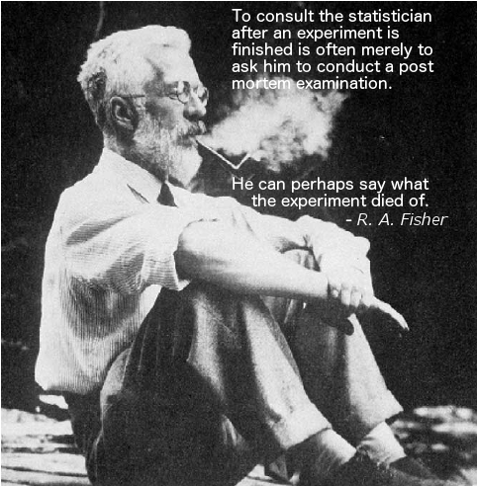
Is it science?
Suppose I wrote up our experiment with its conclusions and sent it to your journal.
The sample was not random – in fact, highly non-random! (SEO)
The “heuristics” used to clean up the data -- not explained, subjective
Are the “major terms” significantly different in importance from the rest of the terms?
How did you objectively quantify “importance”?
Where and what is the control?
What was your hypothesis?
You can use the techniques of data science without doing science at all, however…

Slide 15
Every scientific hypothesis begins with intuition
The techniques of data science, plus the right data, can
help you develop and expand this intuition
reveal patterns that stimulate a desire to explain them.
Your analysis may give you a hint about the explanation, but the basic principles you learned in college and grad school still need to be applied to “prove” your hypothesis correct.
This may include biological ‘wet lab’ experiments!
Approach data science as you would any assay, tool, or technique: like a scientist.

Slide 16



Why “Data Science” Now? (or: Why is statistics suddenly sexy?)
The Internet Revolution : data generation and availability
The Open Source Revolution : freely available computational tools of high quality
The Cloud Revolution : commoditization of computing resources

Slide 17
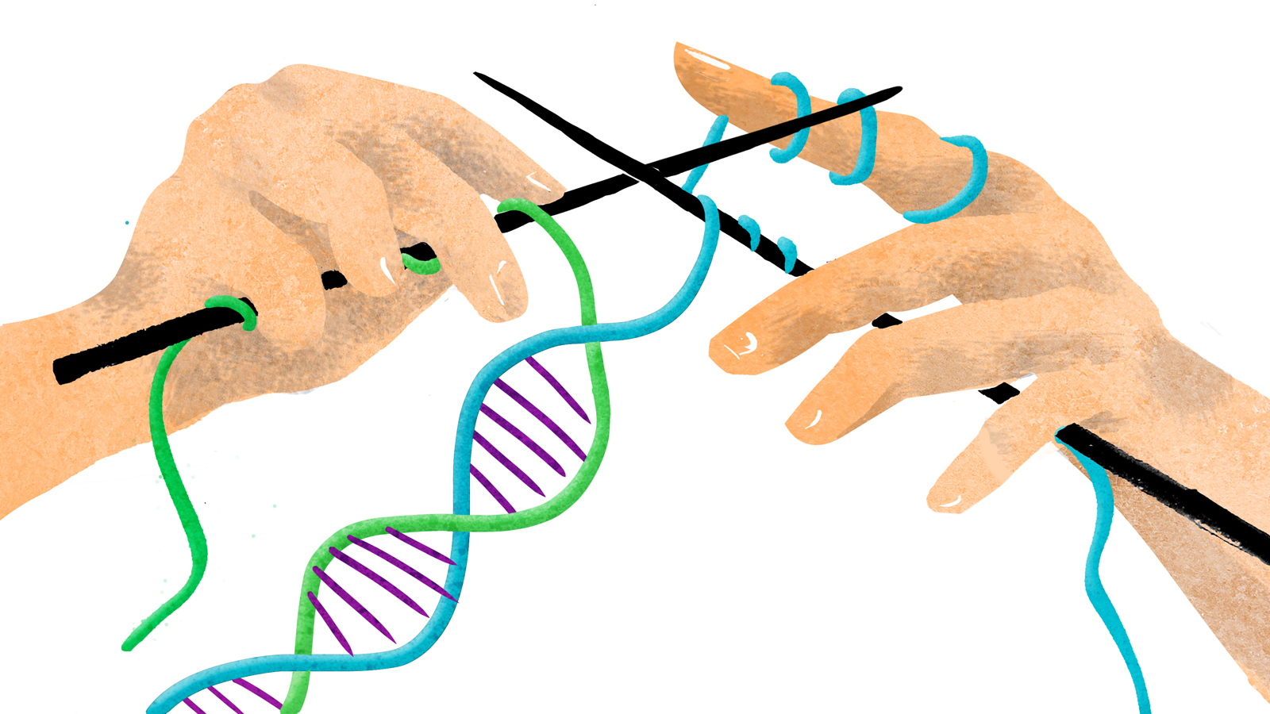
But ... Data Science is in our DNA (🤣)
How many have done a BLAST search on a sequence?
How many have used a genome browser?
How many have clicked around the Genomic Data Commons?

Slide 18
What drives data science?
Data
Questions
Intuition
Sequence analysis is
a good case study.
Tools

Slide 19
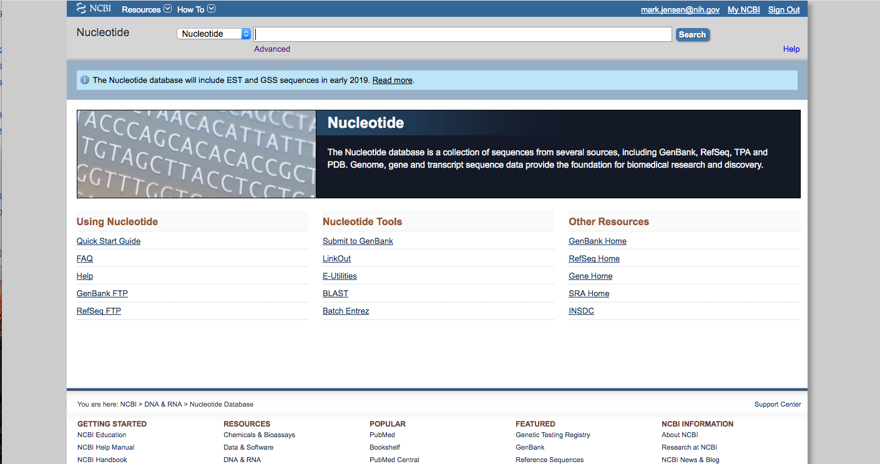
Like E. coli in fresh LB!
https://www.ncbi.nlm.nih.gov/genbank/statistics/

Slide 20
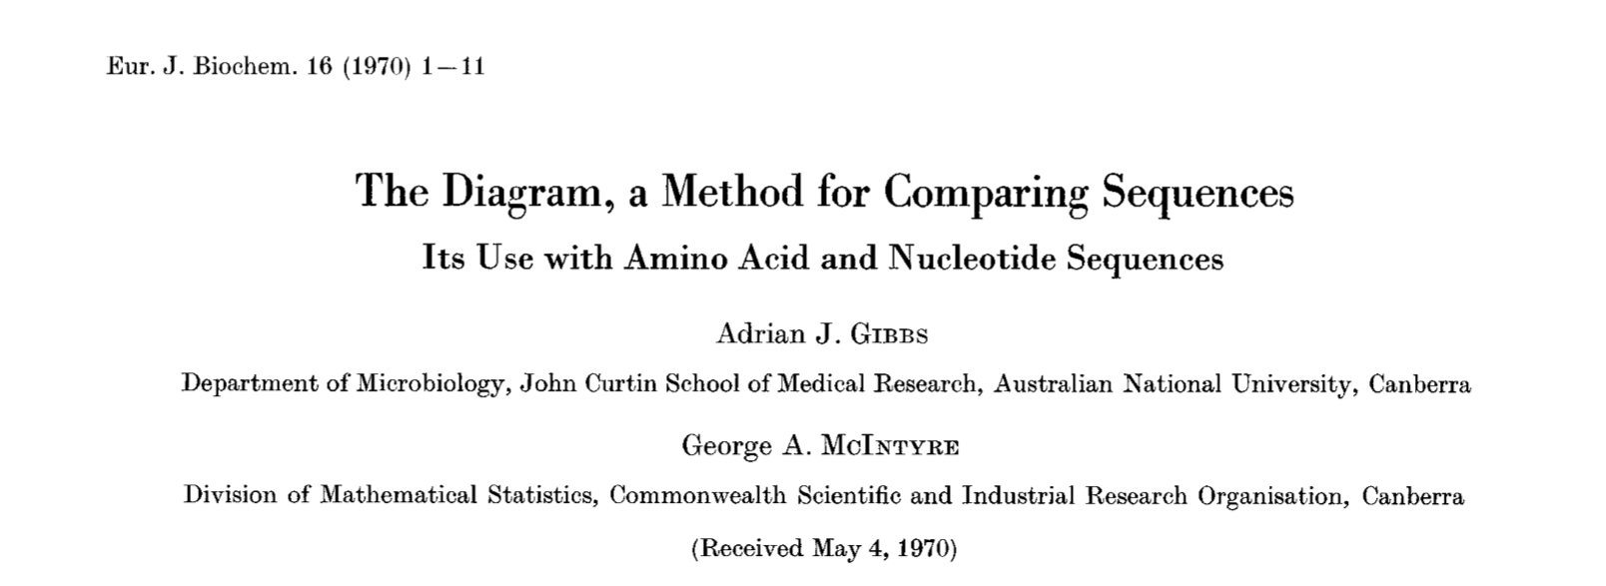
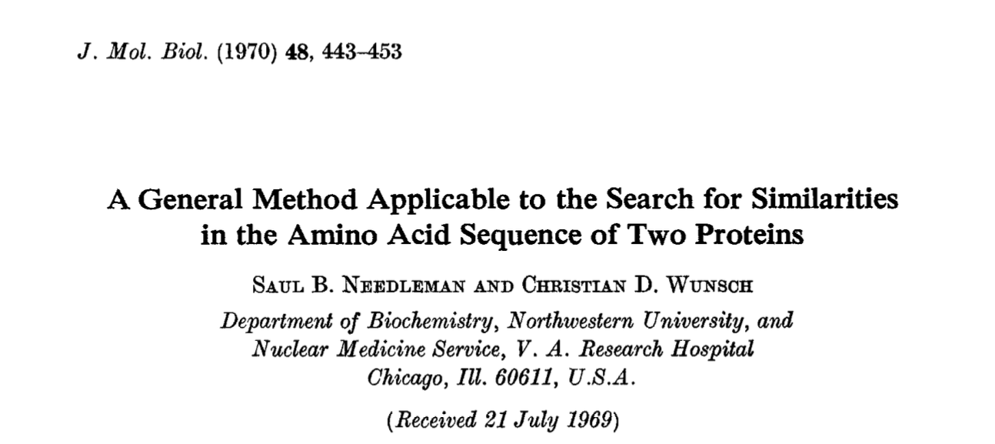
1970 : Compare 2 sequences
Dot plot
Needleman-Wunsch
https://febs.onlinelibrary.wiley.com/doi/abs/10.1111/j.1432-1033.1970.tb01046.x
https://www.sciencedirect.com/science/article/pii/0022283670900574?via%3Dihub

Slide 21
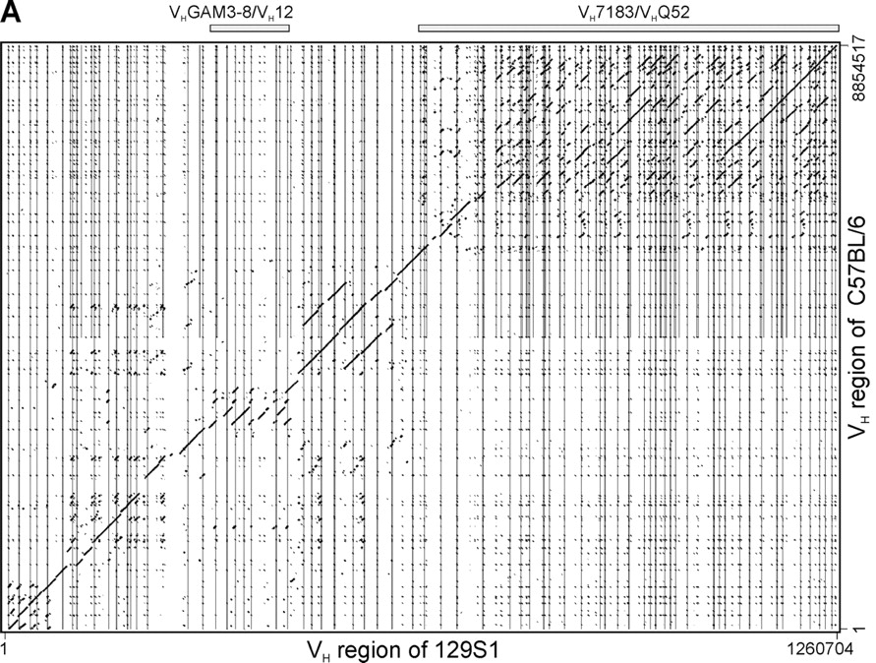
http://www.jimmunol.org/content/179/4/2419

Slide 22
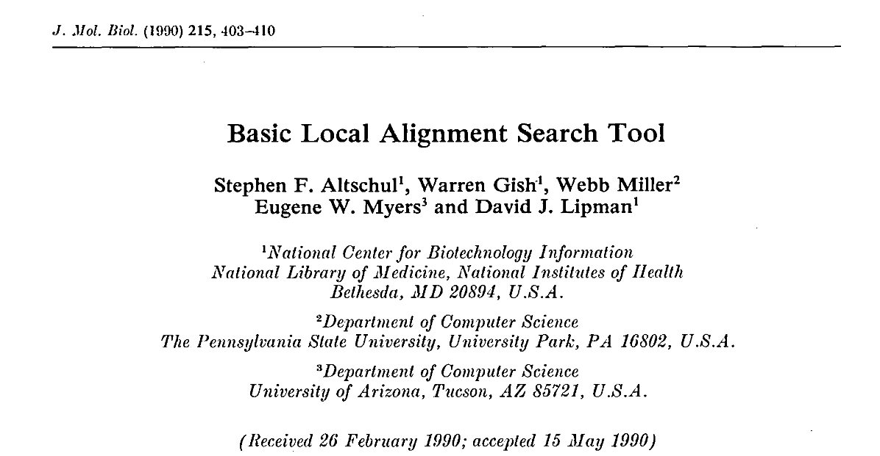
1990 : Compare 1 sequence against many (FAST)
BLAST
https://www.sciencedirect.com/science/article/pii/S0022283605803602

Slide 23
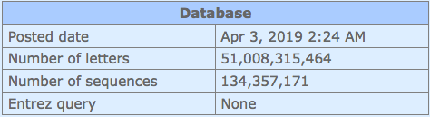
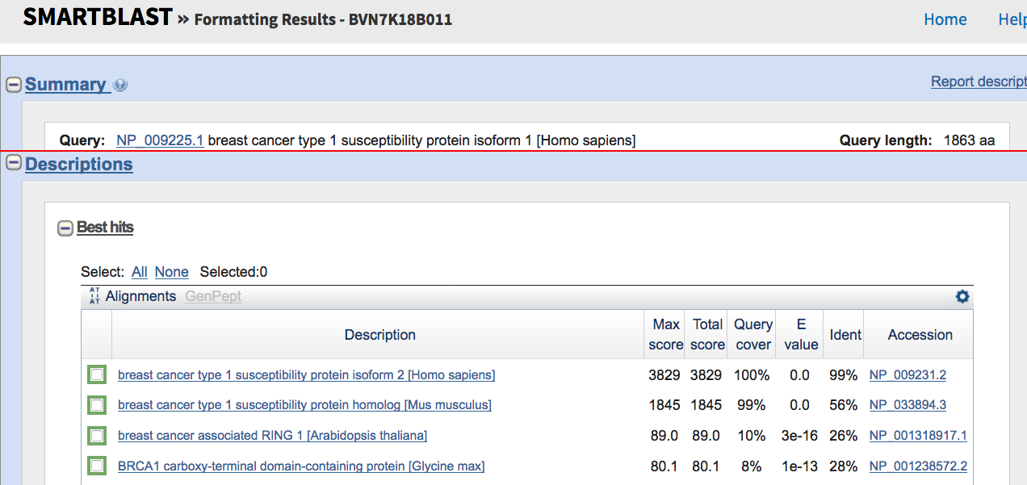
~90 sec

Slide 24
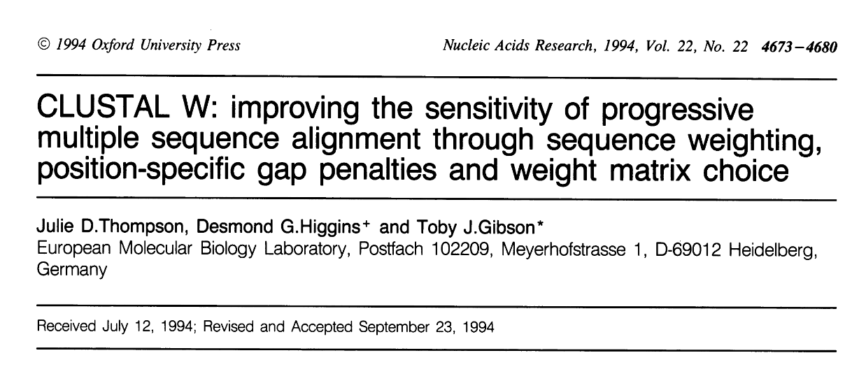
1994 : Align many sequences together
CLUSTAL
https://www.ncbi.nlm.nih.gov/pmc/articles/PMC308517/

Slide 25
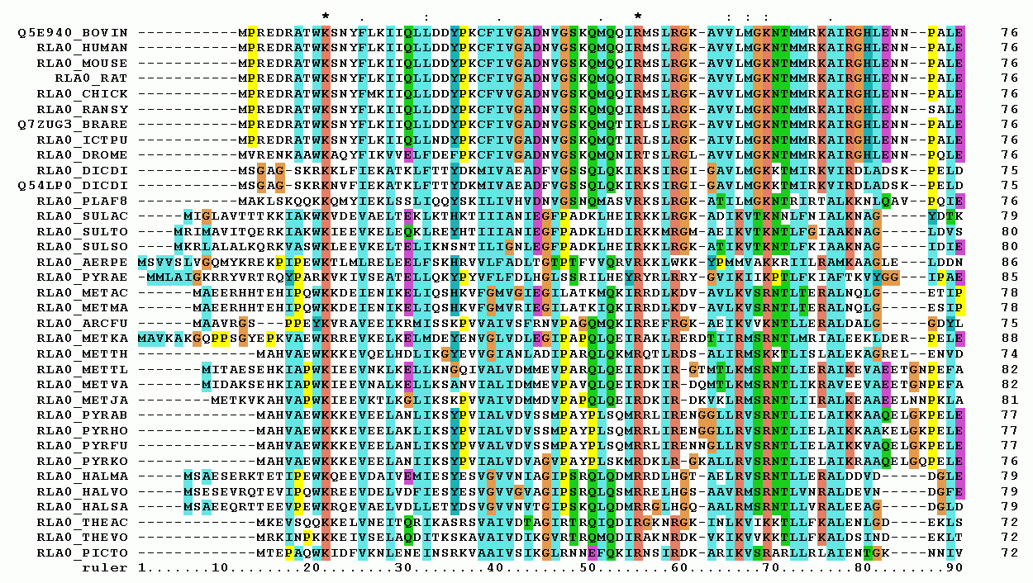
By Miguel Andrade at English Wikipedia - Transferred from en.wikipedia to Commons., CC BY-SA 3.0, https://commons.wikimedia.org/w/index.php?curid=3930704
Notes:
First 90 positions of a protein multiple sequence alignment of instances of the acidic ribosomal protein P0 (L10E) from several organisms. Generated with ClustalX.

Slide 26
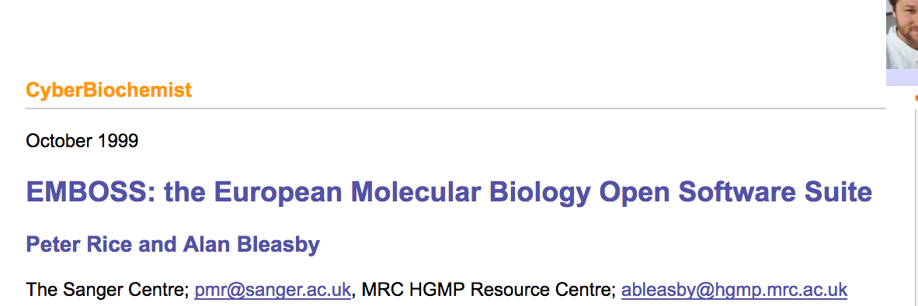
1999 : (Free) Library of standardized tools
EMBOSS
http://www.biochemist.org/bio/cyber/9910/default.htm

Slide 27
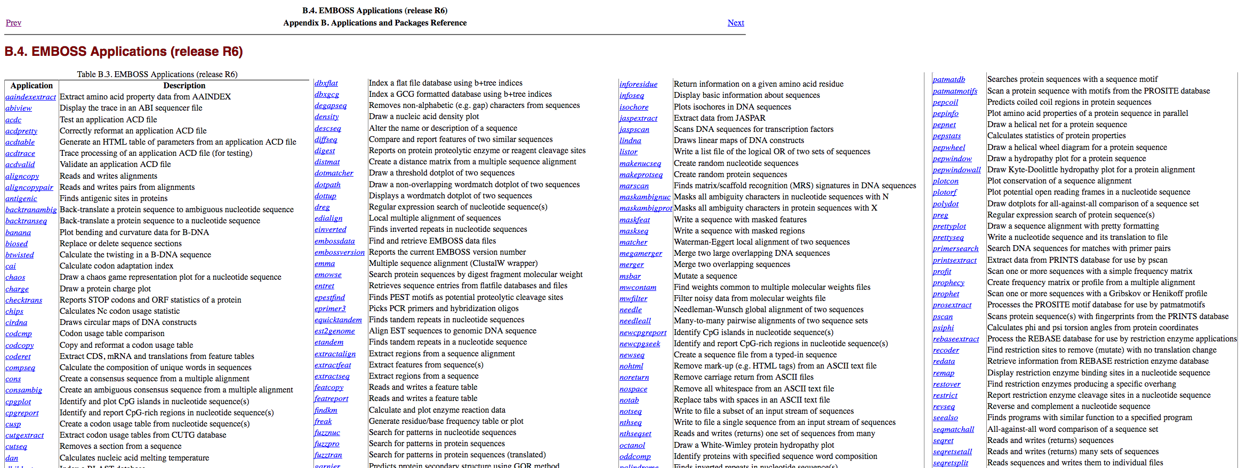
About 200 tools…

Slide 28
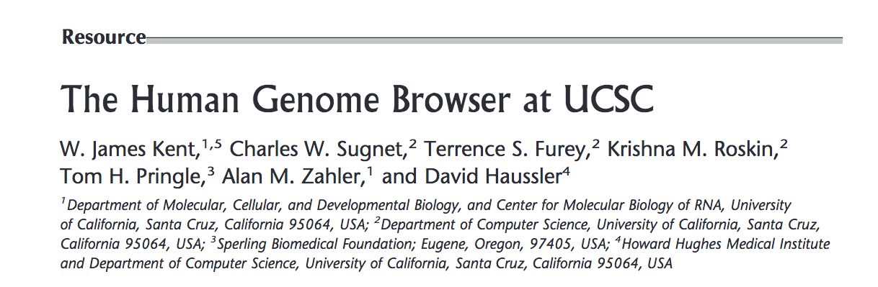
2002 : Display many complex genomic features at once – to biologists
Genome Browser
https://www.ncbi.nlm.nih.gov/pmc/articles/PMC186604/

Slide 29
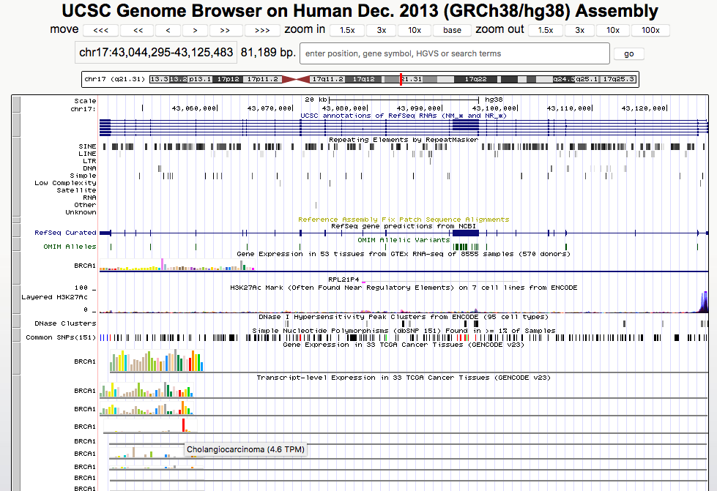
https://bit.ly/2IKWHL6

Slide 30
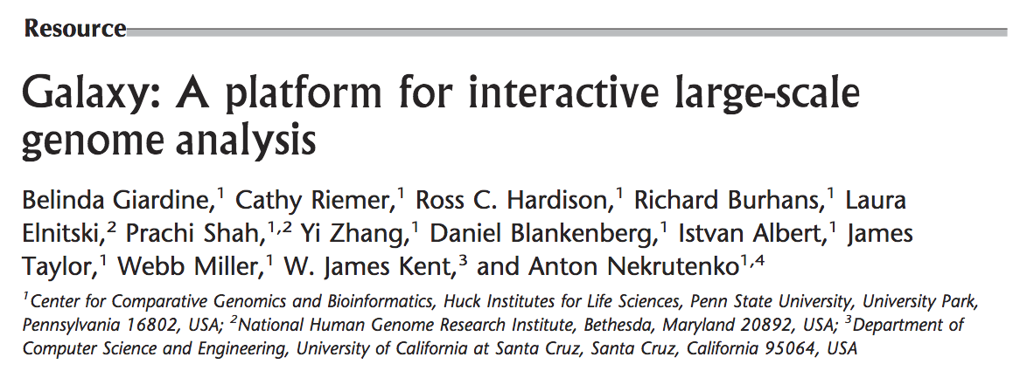
2005 : Enable analysis workflows without programming
Galaxy
https://www.ncbi.nlm.nih.gov/pmc/articles/PMC1240089/

Slide 31
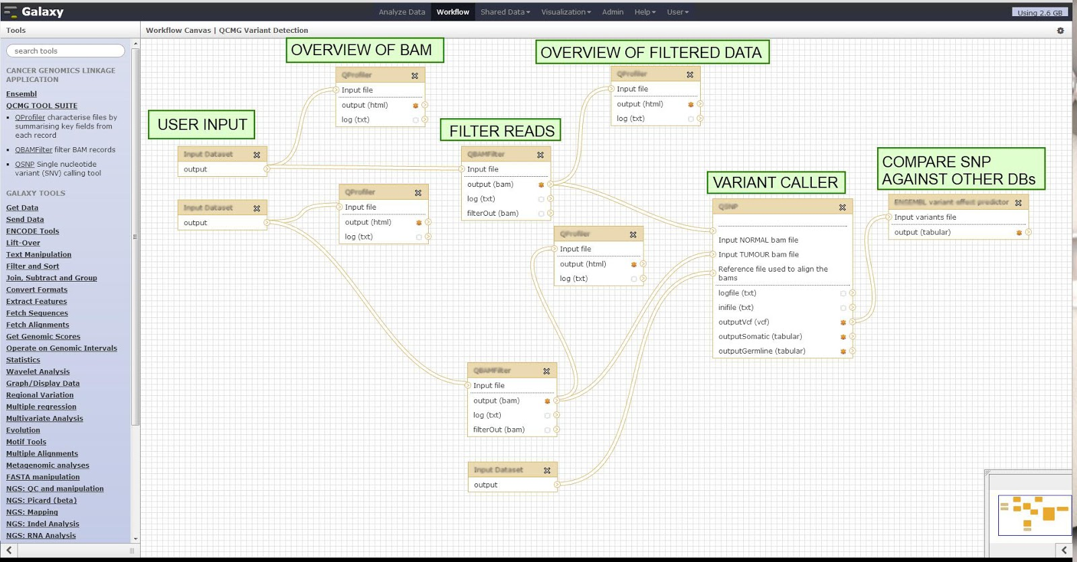
https://bit.ly/2GyDCdr

Slide 32
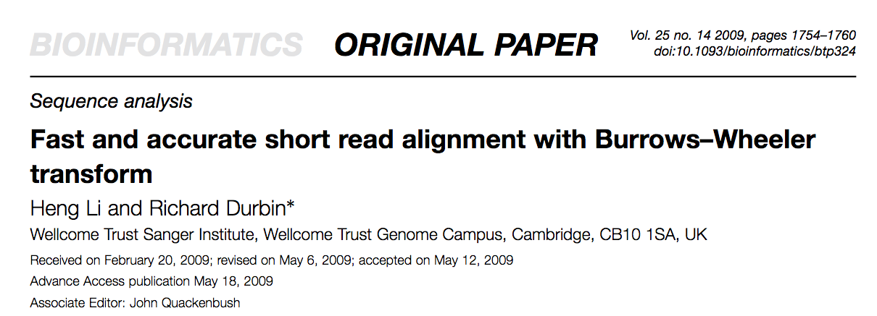
2009 : Align millions of (short) sequences to a reference genome (FAST)
bwa
https://www.ncbi.nlm.nih.gov/pmc/articles/PMC2705234/
https://www.hpl.hp.com/techreports/Compaq-DEC/SRC-RR-124.html

Slide 33
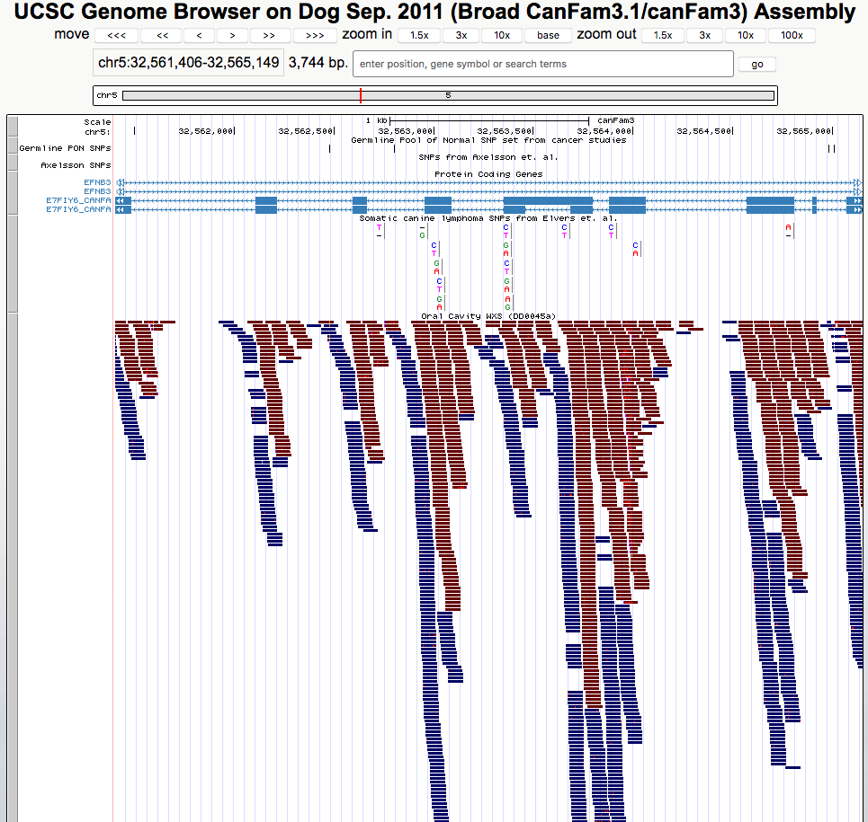
65 million reads
aligned in O(minutes)

Slide 34
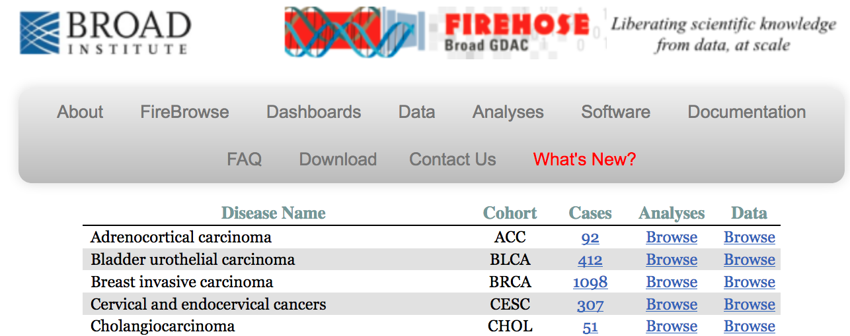
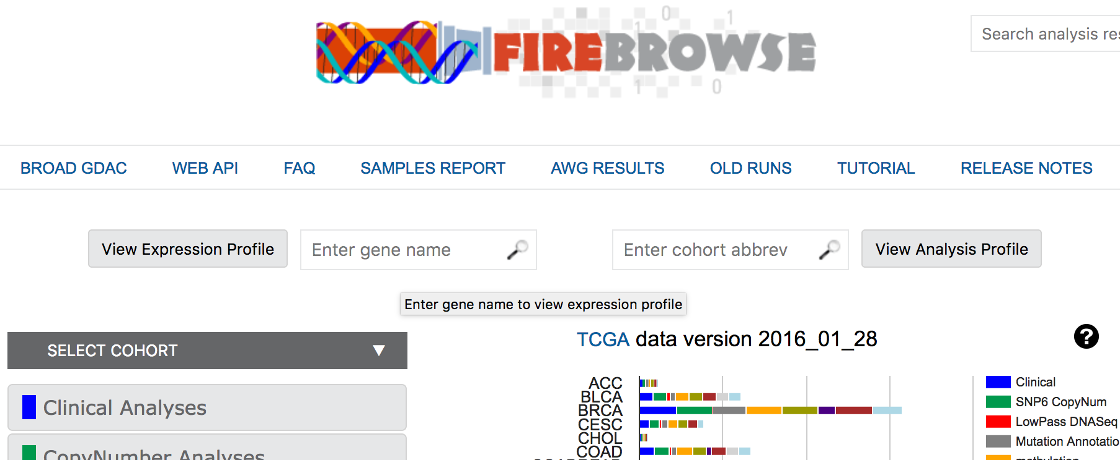
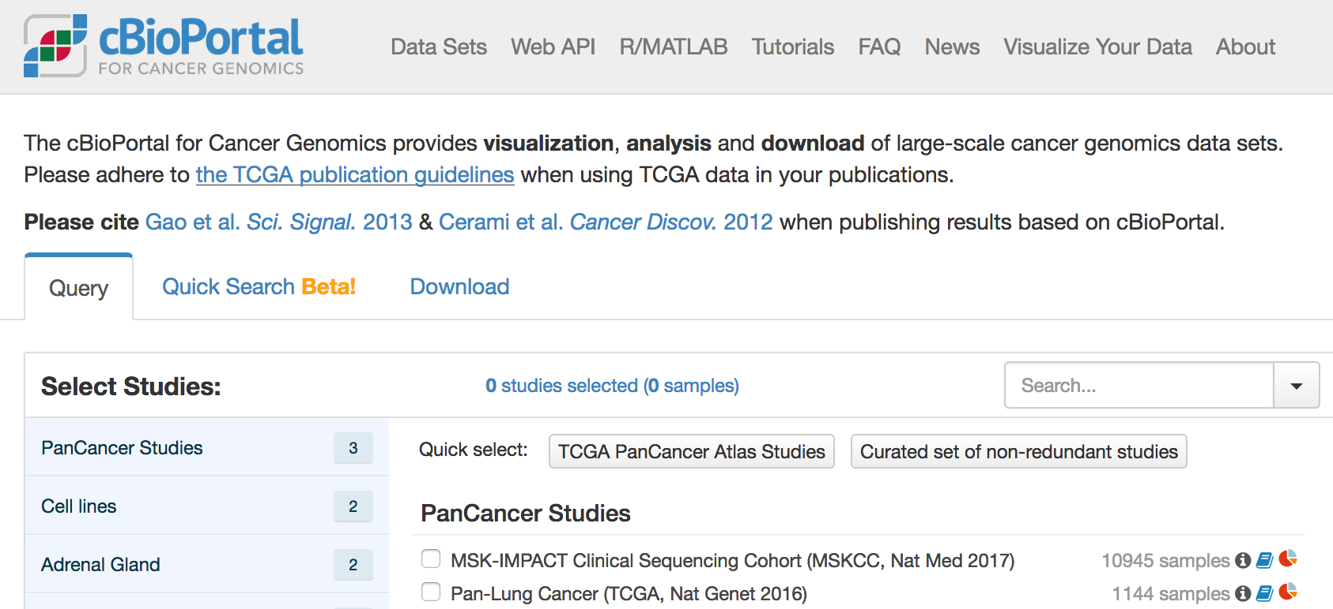
2012 : Automate complex analysis for thousands of cancer genomes – and provide tools for biologists to explore
TCGA tools

Slide 35
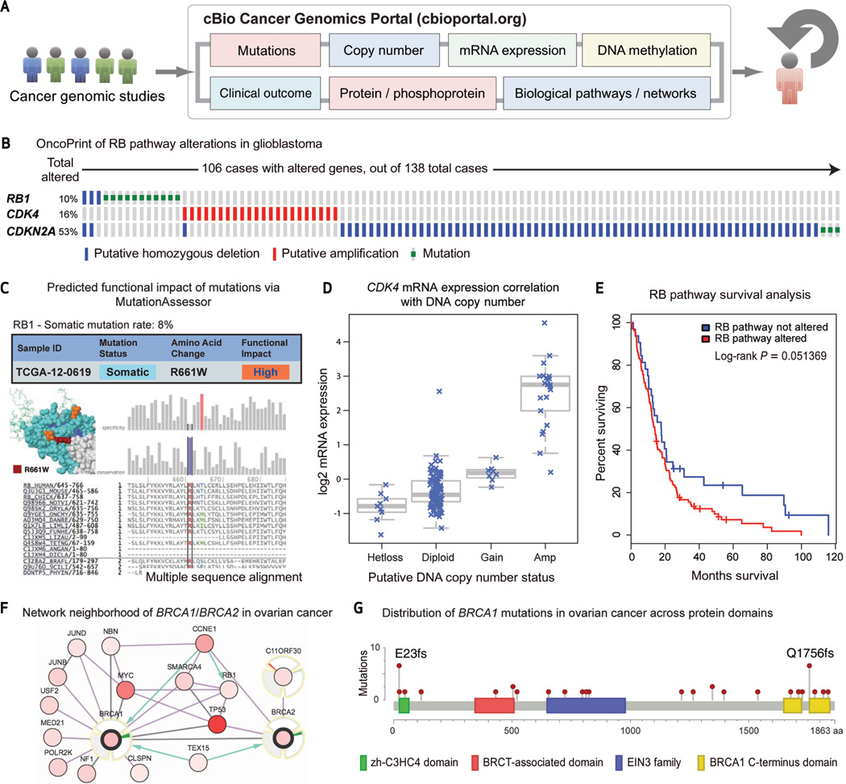
https://www.ncbi.nlm.nih.gov/pmc/articles/PMC3956037/
http://www.cbioportal.org/

Slide 36
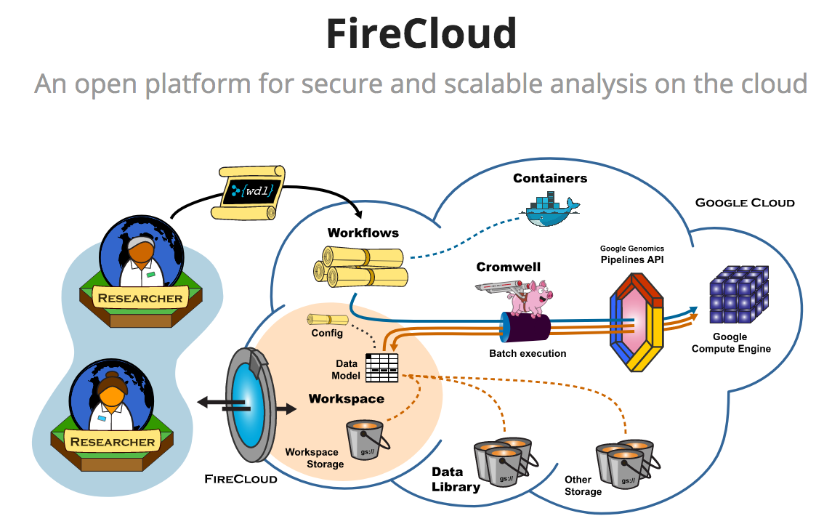
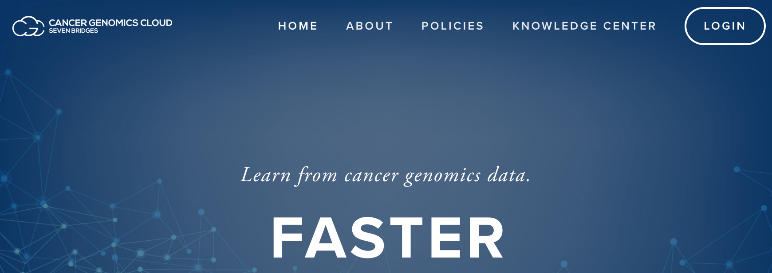
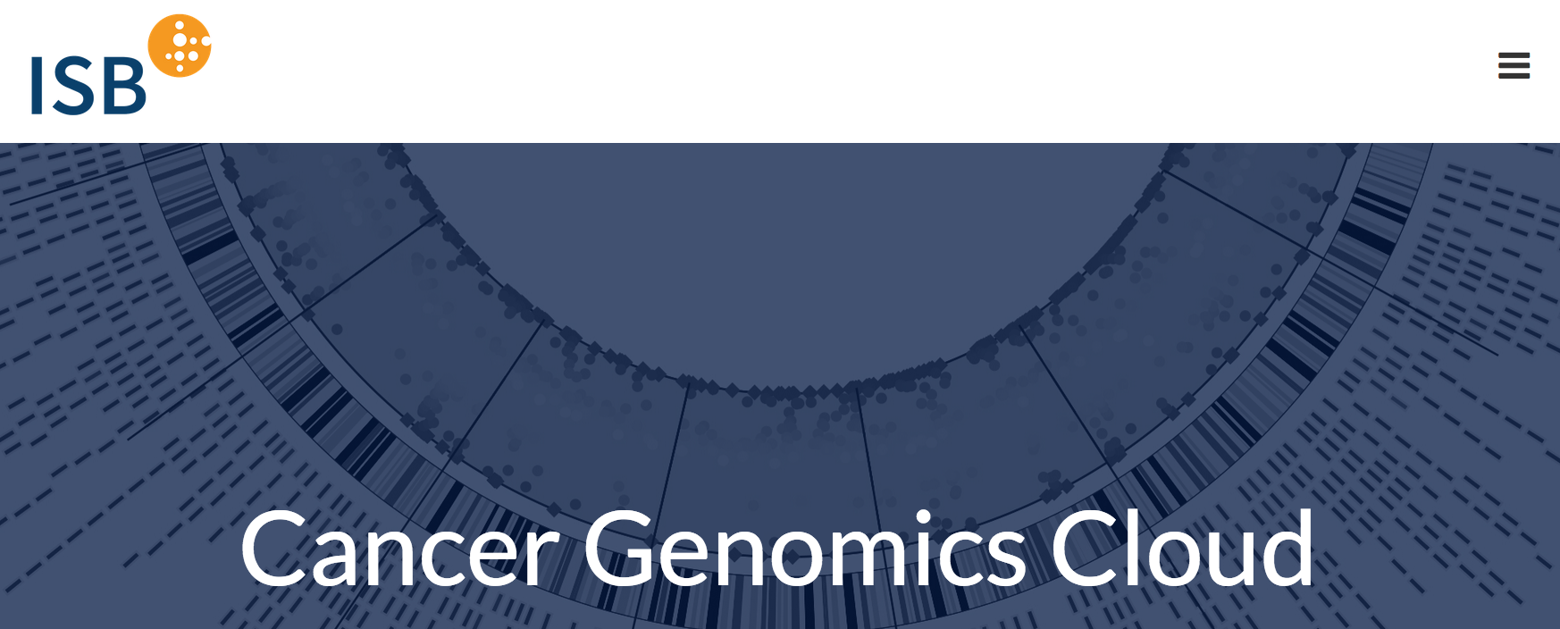
2014 : Computational resources with “all of the above”, available to any cancer researcher
Cancer Cloud Pilots (now “Resources”)
https://www.cancergenomicscloud.org/
https://systemsbiology.org/research/cancer-genomics-cloud/
https://software.broadinstitute.org/firecloud/

Slide 37
Observations
New algorithms (which can be esoteric and “inaccessible”) can pave the way for new visualizations and other data reductions (which are broadly accessible)
An important strand (🤣) in sequence data science: developing technology to reduce the technical burden of data science
Making the technology itself accessible to non-technical investigators
Data science seems like a mountain, but is more like a river

Slide 38
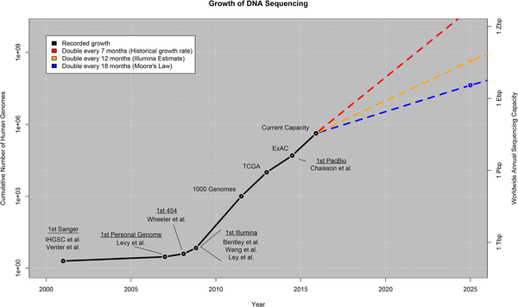

Fig 1. Growth of DNA sequencing.
Stephens ZD, Lee SY, Faghri F, Campbell RH, Zhai C, et al. (2015) Big Data: Astronomical or Genomical?. PLOS Biology 13(7): e1002195. https://doi.org/10.1371/journal.pbio.1002195
https://journals.plos.org/plosbiology/article?id=10.1371/journal.pbio.1002195

